Slide 1

Multi Select and Delete Query
Adam Hassler
Senior Software Engineer
Blackbaud

Slide 2
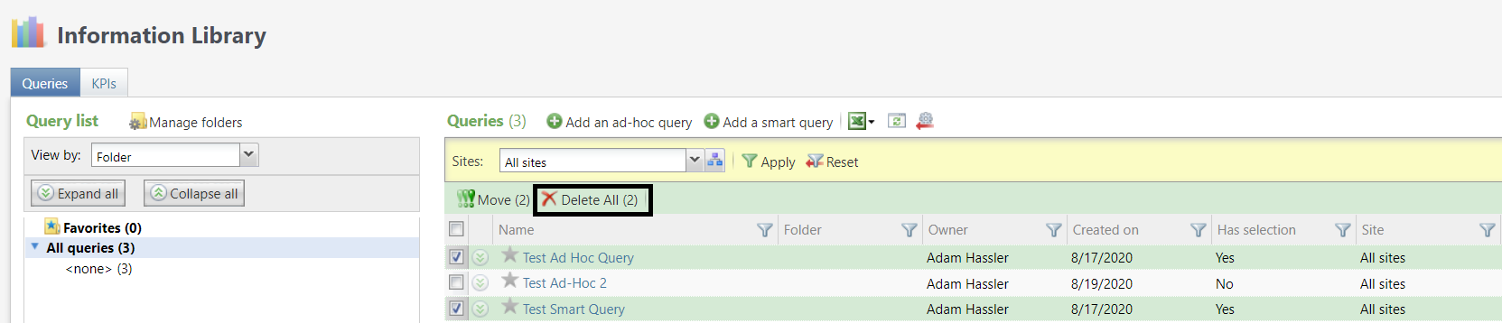
The Initial Vision

Slide 3
First Attempt
Use the same record operation that delete already uses but run it for multiple queries
This quickly ran into an issue

Slide 4
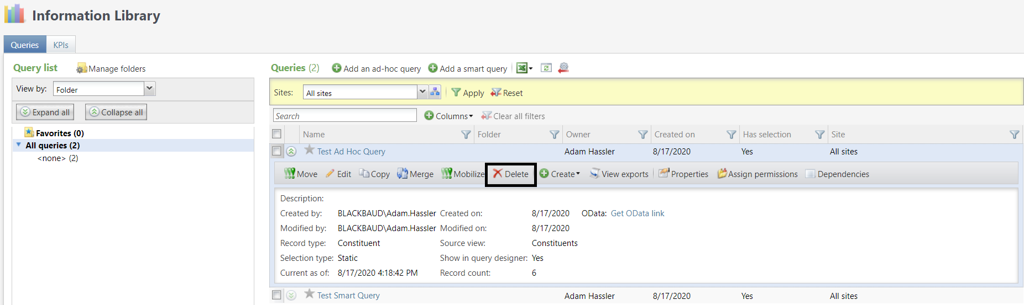
This…

Slide 5
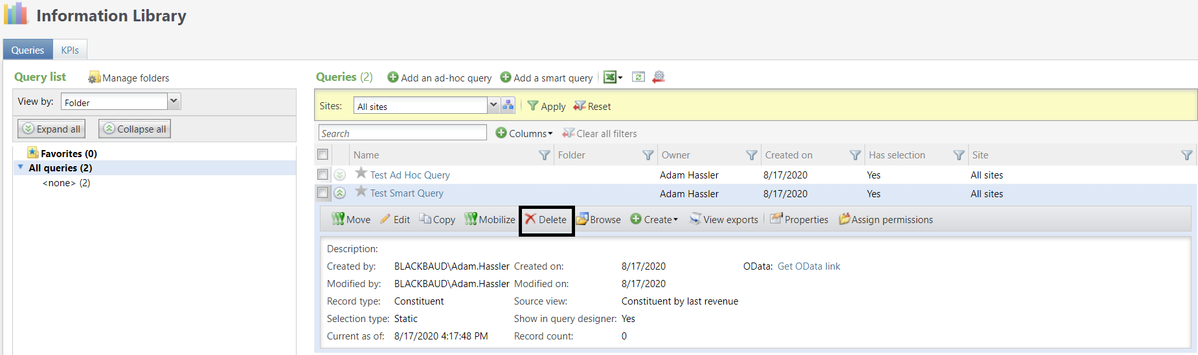
…is not the same as this.

Slide 6
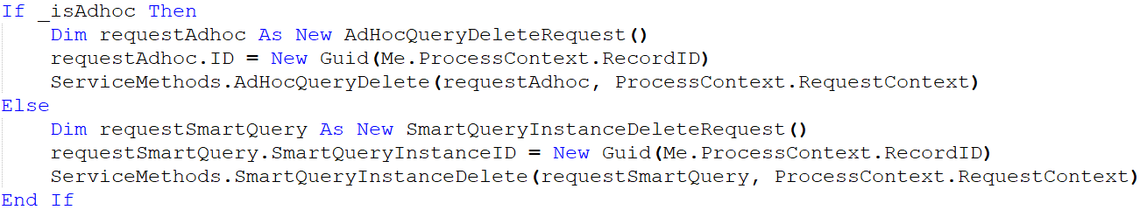
Revised Approach
Create a new SQL function to determine if record id corresponds to ad hoc and smart queries
Create a new record operation that calls the SQL function
Delegate accordingly

Slide 7
There Is Still an Issue
It may not seem like the new record operation to delete multiple queries at once should introduce any new error cases.
However error messages in Infinity platform are typically handled by throwing an exception.
When an exception is thrown the record operation stops.
In this case, the record operation entails multiple deletes.
Thus if one of the records can’t be deleted, any others that remain aren’t deleted either.

Slide 8
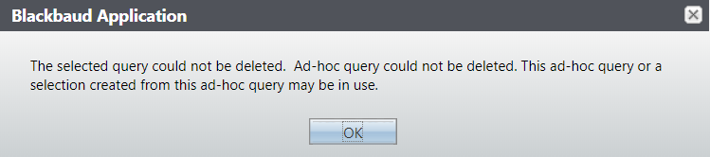
Adding a Try/Catch
Catching an exception is easy enough
But then no error message is displayed

Slide 9
Initial Error Handling
In the initial attempt to protype this functionality, my partner and I were running low on time
We created a table spec which stored the queries that had errors and we added a boolean column to the view spec to pull its value
It was true if there had been an error deleting the column and false otherwise

Slide 10
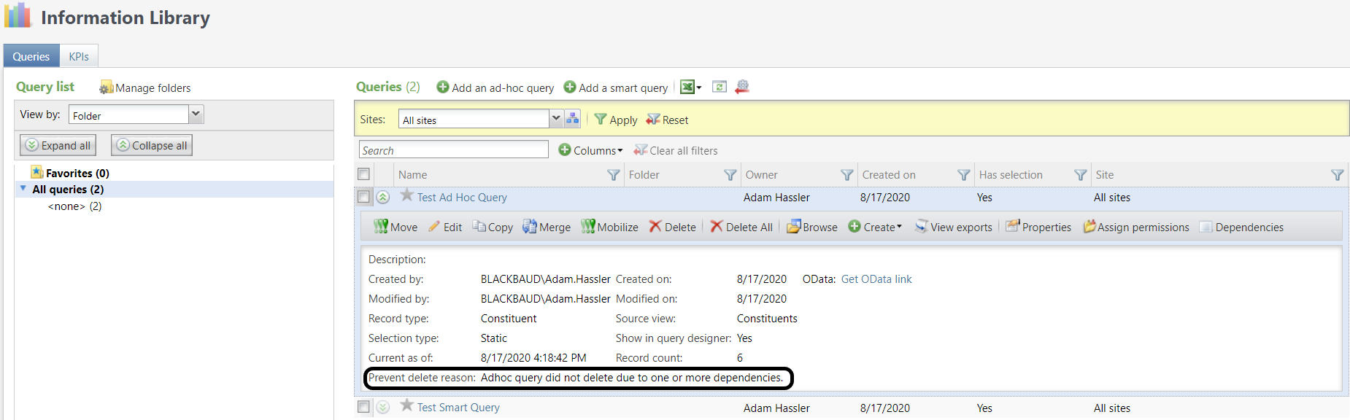
Our Current Approach to Displaying Errors

Slide 11
Error Handling
Create a table spec to hold the query id and the error message
Add a stored procedure spec to add errors to the table
Change the record operation to call the stored procedure when catching
Modify the view form for queries to join to the error table and display the error
Update the UIModel for the view form to hide the error column when there has not been any query deletion errors

